Slide 1
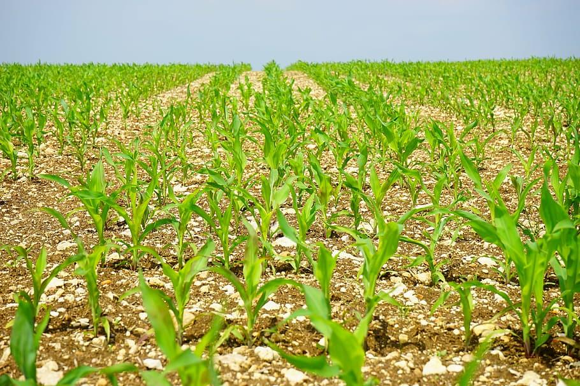
Data Science in Agriculture
Along with Big Data

Slide 2
Role of Data Science in Agriculture
Data Science uses mathematics, statistics, and programing to create tools that help spot patterns and find the best methods for managing decision making.
In agriculture that is focused on not just plots and yields but also economical and sustainability.
Most commonly there is a pipeline methodology used that is broken down into at least five phases.
Data collection > Data management > Visualization > Modeling > results/feedback loop
The methodology helps with understanding human tendencies, naturally occurring phenomenons, and most importantly prepare for the potentially a bad season.
Increasing profitability by optimizing food production, harvesting, and transportation when possible.

Slide 3
Applications of Data Science
Yield forecast: optimizing the harvest timing and mil throughput
Example: forecasting the sugarcane fields with their Sucrose content being at its optimal levels in order harvest not just the most sugar but a largest amount as well
Climate patterns: analyses climate driven trends like ENSO and seasonal effects
ENSO or better known as El nino is a type of periodic fluctuation that affects air pressure, sea surface temperature, and the general flow of the atmosphere. It occurs every 2-7 years.
With fluncations, it's important to keep track of when these phenomenon can occur as they affect not just the growth of plants, but the harvesting, transportation, and every point.
Pest/Disease detection: using image and spectral analytics during planting for early detections of infestations and plague.
Spectral analytics use data of UV to infrared sensors in order to form an image of the properties to easily find anomalies in a cluster

Slide 4
Applications of Data Science continued.
Precise management: micro managing all levels of human contact with the harvest at all points
Such as the fertilization used to best give the highest probability of a successful growth to the ripening application that can be predicted with analytics.
As it is impossible for a whole harvest to be ready at the exact same time, there needs to be data points for when its the optimal time to start picking and reduce waste.
Supply chain: the logistics and resource allocation are based on predictive outputs
Knowing the timetable that the crops have in order to go from the farm to a store is the first of many steps to securing food does not go to waste as it travels to its destination.
The transportation method with the cost vs freshness is a data point that can influence the whole process

Slide 5
Common Models
Generalized Linear Model
Baseline models used for continuous target data. Meant to provide easy to follow entry data
Tree ensembles & boosting
Machine learning technique with a focus on aggregating a lot of “weak” decisions to create an accurate “strong” predictive model.
Boosting corrects the errors in the previous sequence which leads to more accurate up to date results
Time‑series and deep models
Used mostly for finding anomalies in the finances of the operation and meteorology. It looks for nonlinear patterns using a neural network to find where money is being overspent on as well as forecasting possible out of season weather changes.
ensemble strategies
Combination of all the models listed before in order to solve problems, one at a time. Its to minimize errors and have the highest accuracy possible.

Slide 6
Using the Models
Preprocessing: finding the Min and Max for numeric features
Feature filtering: retain variables from prior model(s), before retraining with a new run.
Validation: confirm data points,
Model selection: after confirming the data as accurate, its time to choose the most efficient model to use
Explanation: make a graph, table, etc. in order to present the output of the data from the model to everyday people. It must be easy to follow.

Slide 7
Tying in with Machine Learning
Machine Learning, known as ML and AutoML. is the primary tool for capturing complex, non‑linear patterns and automating the model.
combine ML predictions with statistics and domain expertise, will validate across seasons and regions to avoid incorrect conclusions.
The models are focused on ecological and productive senses. It hopes to maximize not just earnings but also sustainability.

Slide 8
Big Data Analytics
Big data is a process where massively complex data and varied datasets are examined using AI, statistics, and machine learning.
In the case of agriculture it is common to use person interviews, workflow diagrams,, weather history, financial records, and historical environmental reports.
Technologies such as AI are used across precision agricultural and livestock cases. Cross referencing each other in order to find trends and anomalies.
Big data is more about providing solutions to the agricultural problems while the Data science was about collecting the facts, informations, and patterns.
A mixed method design is used but it is built on the information gathered internally mostly to solve the unique problems..

Slide 9
Big Data Analytics continued.
Big Data has the potential to provide solutions to environmental variability, seasonality, and fragmented operations. As it is data driven, it provides a rigid plan for the future of farming. Sadly agriculture is an uncertain field with low margins and biological cycles that can be extremely punishing. Which leads to a low adoption of new ideas and techniques.
As demand continues to grow throughout the world, becoming more productive has become a necessity in order to survive in the industry. Leading to some farmers and investors to begrudgingly to embrace not just Big Data, but AI as a whole to gain an edge.

Slide 10
The Four Analytics Leading to Change
Drivers of change: the data and commerce are the main driving force in getting big data and data science to the foreground of agriculture.
The 4 Vs: Volume, Velocity, Variety, Veracity
What farmers care about is how much their yield will increase by, how quickly, can it help them diversify, and most importantly is it trustworthy/accurate.
Solution Maturity: the readiness and availability of technology
Most farmers and investors tend to want the tech to be affordable and widespread within 3 years. They want a proven track record
Financial consideration: depending on the scale of the farm, if its too small, they might not be able to afford all of the resources needed for data science to work. Or if the farm has investors, they will want to know how long till they get a ROI.

Slide 11
Government funding
Currently the USDA offers grants and fundings to research in advancing agricultural sciences, It has a hard focus on addressing issues with food production, safety, and rural economies.
It was originally established in 2008 as part of the farm bill but was given more attention in 2018.
In 2024 The Consolidated Appropriations Act allocated another $445.2 million to projects as sustainability with a growing global population has become a center point.
Anyone from private companies, public services, universities, to researchers can apply for a grant. As the landscape changes more money will continue to be poured into research and development.

Slide 12
Research Example pt 1
MISSISSIPPI STATE UNIVERSITY was granted $591,250.00 for research in “Harnessing AI to improve yield monitor data veracity to increase the adoption of precision agricultural management”
Their methodology is based on creating a Convolutional neural network and long term short memory based DNN models. They will monitor 5000 acres and use historical data along with it to remove random errors that pop up
Their main goal is to find out the crop mass, moisture levels, and use machine parameters to estimate an accurate yield.

Slide 13
Research Example pt 2
UNIVERSITY OF FLORIDA was granted $591,460.00 to research an “AI-driven genomic and crop simulation models for enhancing plant breeding using high-throughput phenotyping”
Their methodology is to combine state of the art AI algorithms with standard crop simulation models. Using low cost RGB cameras to monitor and collect the data. The harvest data collection will be of 7000 plots where they will measure the tuber length, width, weight, color, and deformities.
Their main objection is to cross breed stronger plants at a lower cost

Slide 14
The Future of Data Science in Agriculture
Agriculture is a field that might seem stagnated but like with everything else in today’s world, it continues to change and advance.
There are even university level programs that have a sole focus on data science in agriculture. In North Carolina State University for instance, they have an Ag Data Science bachelor of science program. As well as many universities having research teams for the topic as well
Most importantly there are also many investors such as blackrock now paying consultants to help increase their yields and help future proof operations. As the world continues to change and climate change takes its toll, Data science will play a vital role in not just in the economics side of agriculture but also our survival as a species.

